Slide 1
ITMD 529 Data Analytics
October 13 2016
Zappos Sales Analysis
Aditya Dixit
Anusha Bondili

Slide 2
Table of Content
Business Scenario
Business Objective
Selected Data
Data Flow/Processing Steps
Exploratory Data Analysis Results
Regression Modeling Results
Summary/Conclusions

Slide 3
Business Scenario: Zappos Sales Analysis
This dataset consists of the sales data for zappos for the year 2013
The dataset consist details of orders placed by various customers using their cellphone s through various sites of zappos of
This data consists of sites such as Acme , Widegtry, Botly , Sortly , Tabular , Pinnacle through which the orders are placed .
This dataset also contains the details for the type of operating system used by the customers to place their orders ( Androif , Mac , Linux , Chrome , IOS)
The dataset also defines the type of cutomers
If the customer is a new customer then he is type 1
If he is a returing customer then he is type 0
It also has the total number of visits by the user and also the search page views and the product page views

Slide 4
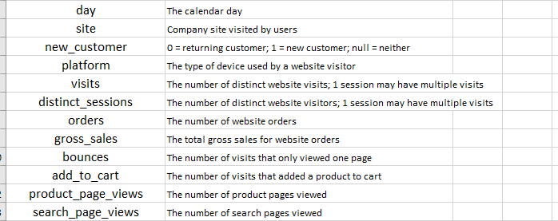
Business Objective: Zappos Sales Analysis
Metadata

Slide 5
Business Objective: Zappos Sales Analysis
To build a regression model to predict the factors affecting the gross sales .
Gross sales is response variable where as predictive variables[X’s] based on Pearson coefficient are
Add_to_cart
Orders
Visits
Platform
Site
Number of observations in the dataset are: 21061
Total number of variables: 15
Attribute characteristics: Integer, Real
Output variable is Gross Sales
Data is collected over the period of a year 2013.
Data is got from Zappos during an Interview round as a part of the hiring process

Slide 6
Selected Data: Online News Popularity Dataset
Below are the five input variables which effect the response variable Gross_sales in a very evident.
The description of the variable is also explained in the table below
Variable | Description | Type
Add_to_cart | Orders added to cart value | Continuous
orders | The number of orders made | Continuous
Visits | Total numbe of visits to that site | Continuous
site | Website through which orders are placed | Categorical
platform | Platform through which orders are placed | Categorical

Slide 7
Data Flow/Processing Steps: Online News Popularity
Response/ Predictor variable
Presentation Layer
PROC UNIVARIATE
PROC MEANS
PROC FREQ
PROC SGPLOT
PROC REG
PROC GLMSELECT
Gross Sales
orders
Add to cart
Site
Platform
visits
Data Processing
Data Integration
Semantic Layer
Data Processing

Slide 8
Exploratory Data Analysis: Background
The data that is collected is the sales data that was collected for the year 2013 .
The main aim of the analysis is to develop a relationship between Gross sales and a few of the attributes .
The aim is also to figure out which attribute affects the sales the most and increase or decrease of which can help the growth in sales
There are total 15 attributes in the dataset out of which 11 are predictive attributes, 4 non-predictive
All 15 attributes are analyzed using PROC CORR to determine predictor’s co-relation with response variable.
Out 14 predictors 10 are continuous and 4 are categorical attributes.
Continuous variables are analyzed by PROC UNIVARIATE to check the details of the variable and check for the skewness
Categorical variables are analyzed by PROC FREQ to determine which platform and site are the best to increase the gross sales
PROCC CORR is used to view the correlation of all the variables present with the output variable

Slide 9
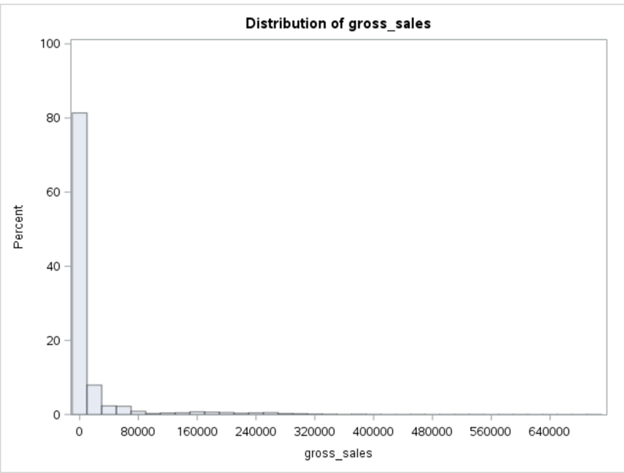
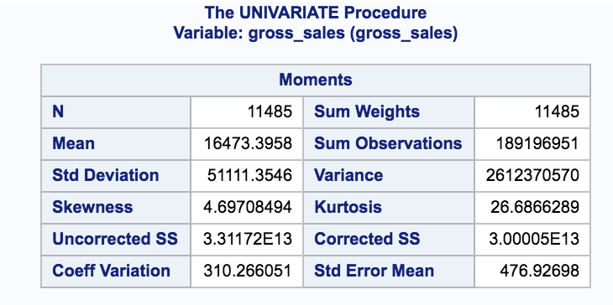
Exploratory Data Analysis Results: Using PROC UNIVARIATE
Response Variable
Gross Sales
Mean of Gross Sales is 16473.3958
Higher the gross sales , better the site for Zappos
Data is highly skewed since Skewness and Kurtosis values are on higher side

Slide 10
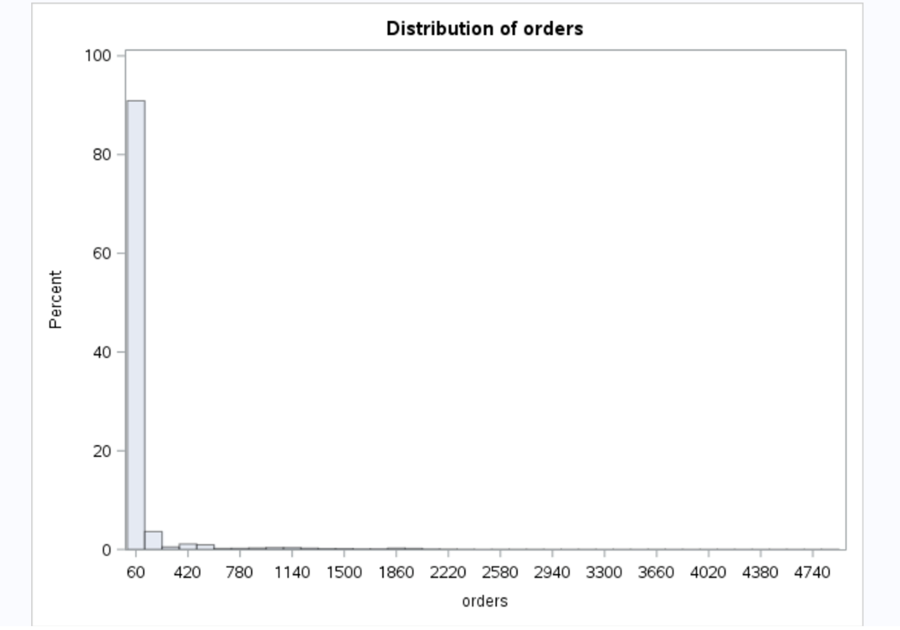
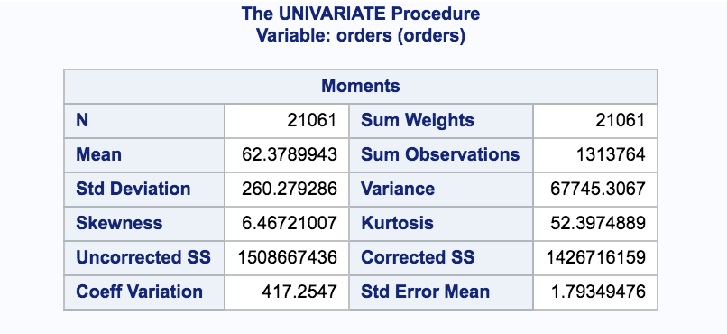
Exploratory Data Analysis Results: Using PROC UNIVARIATE
orders
Mean of orders is 62.3789943
The skewness value here is again on the higher side .

Slide 11
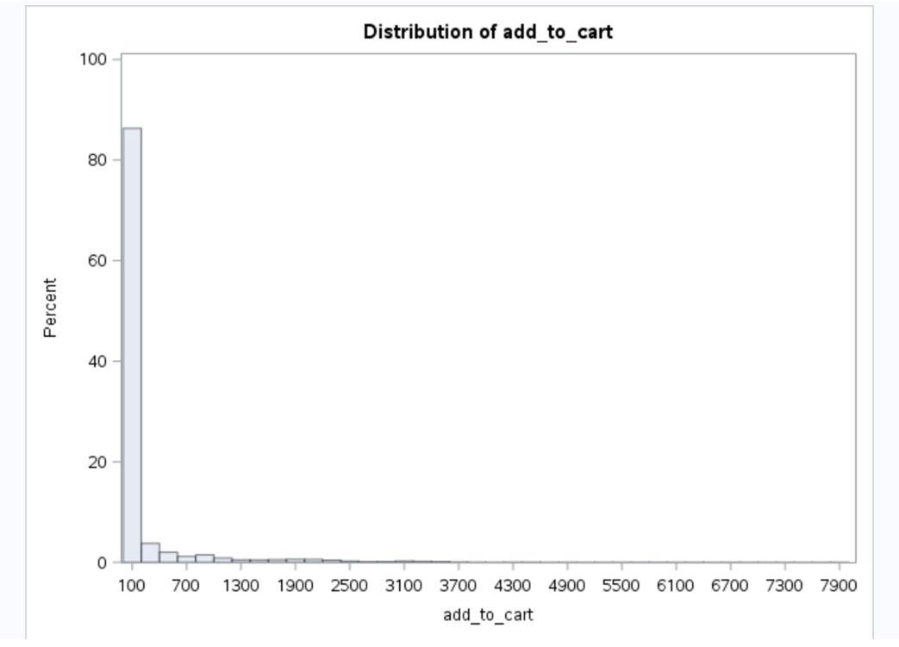
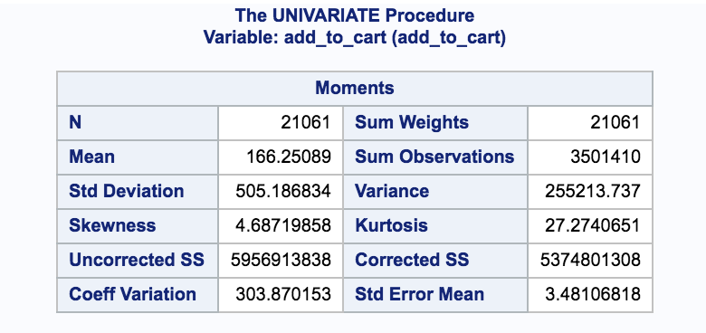
Exploratory Data Analysis Results: Using PROC UNIVARIATE
add_to_cart
Mean of add_to_cart is 166.25089
Data is highly skewed with skewness and kurtosis values.

Slide 12
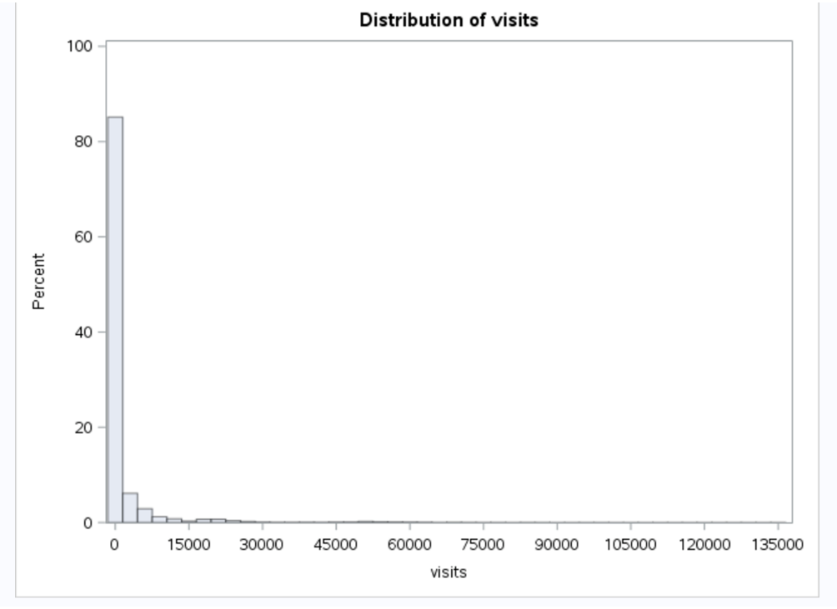
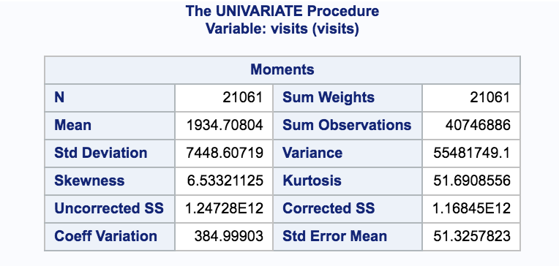
Exploratory Data Analysis Results: Using PROC UNIVARIATE
visits
Mean of visits is 1934.70804
Data here again is highly skewed with skewness and kurtosis values.

Slide 13
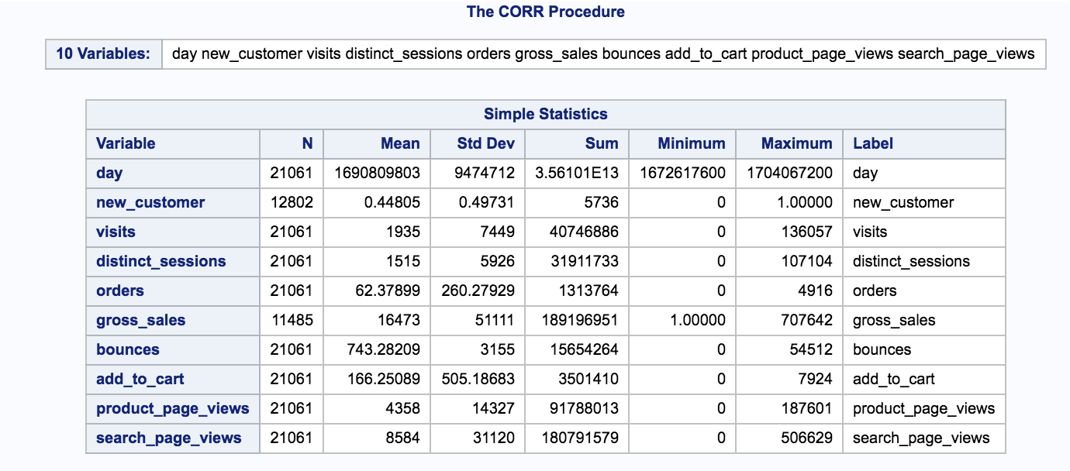
Exploratory Data Analysis Results: Using PROC CORR
Co-relation between all the predictor variables and response variable [Number of gross sales] is analyzed using PROC CORR.
Pearson Coefficient between gross sales and day, visits, distinct_sessions, orders, bounces, add to cart, product page views, search page views is comparatively high considering other attributes which suggests these variables impact response variable in greater way. Is shown in above screenshot.

Slide 14
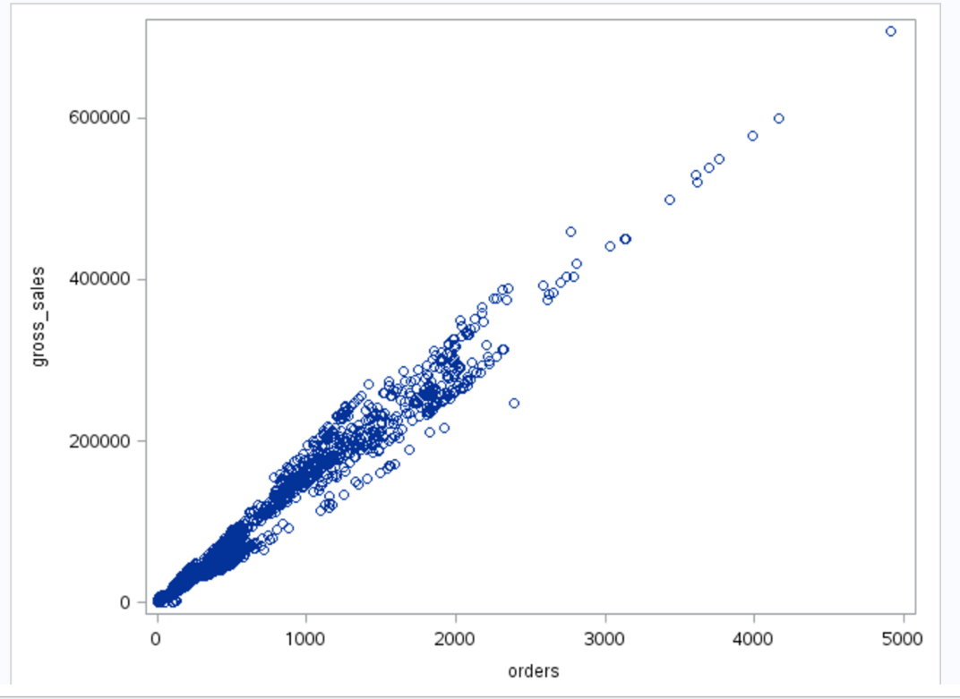
Exploratory Data Analysis Results: Using PROC SGPLOT
SGPLOT for Gross Sales vs Orders
Gross Sales value ranges from 1 to 707642.
Orders attribute has a major impact on the Gross Sales.
Data is highly concentrated in the range of 1 to 15000
Increase in the number of orders increases the popularity .

Slide 15
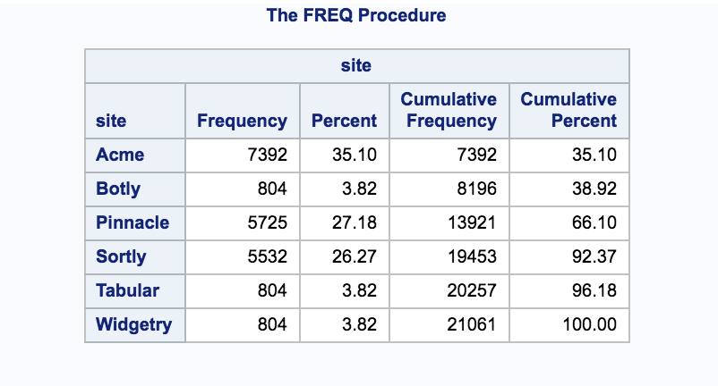
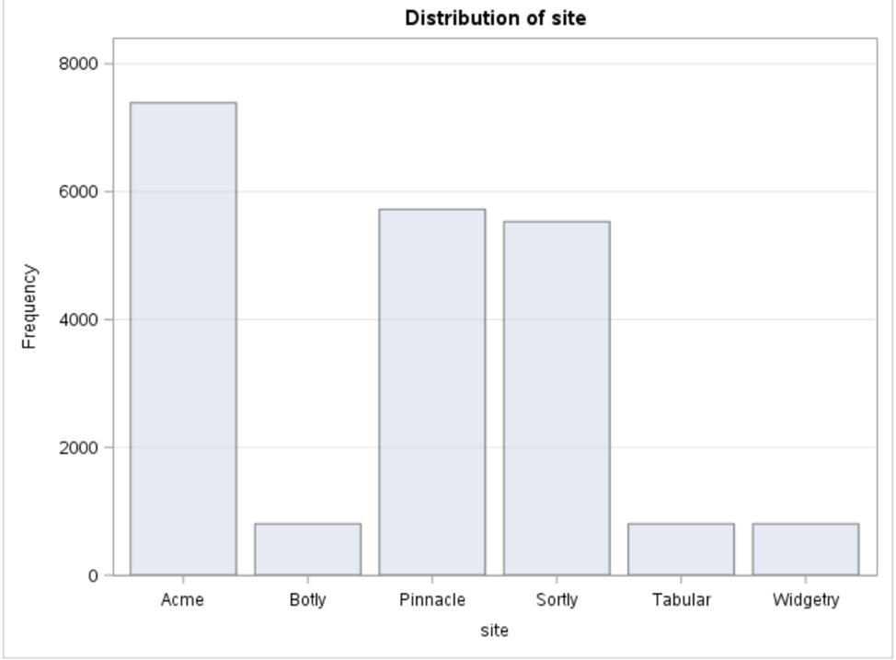
Exploratory Data Analysis Results: Using PROC FREQ
PROC FREQ for Channels/Categories
Compare the site wise distribution of various entries
Most number of sales are in Acme and the least are in Sortly and Tabular

Slide 16
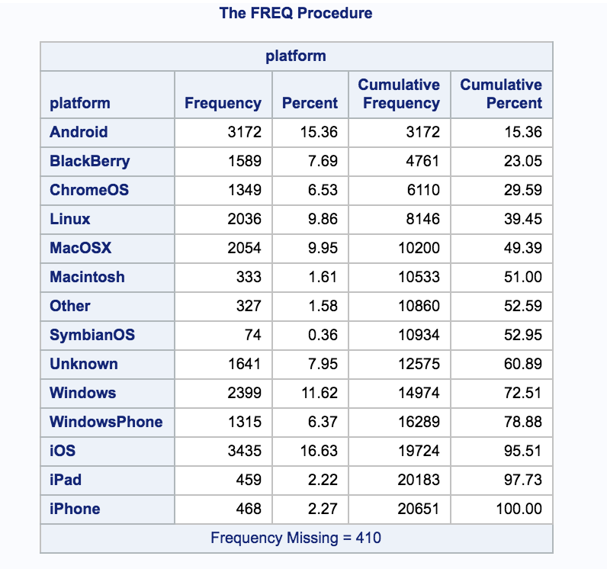
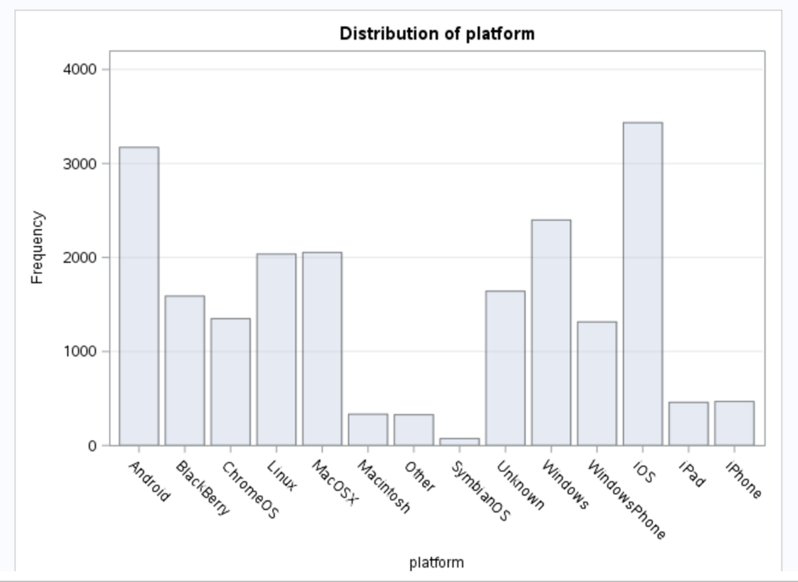
Exploratory Data Analysis Results: Using PROC FREQ
PROC FREQ for platforms to determine which platform is the best ?
Analysing the various platforms thrugh which the orders are placed
Ios has the most number of occurrences while Symbian has the least number

Slide 17
Summary of Exploratory Data Analysis
The value of gross sales range from 1 to 707642
From the graphs and the analysis , the data is highly skewed
Out of 7 statistically important predictor variables we come to conclusion that following 3 are most significantly impact the response variable gross sales are
_orders
Greater the number of orders, higher the gross sales
Add_to_cart
Higher the add_to_cart value ,the value of gross_sales increases
vists_num_hrefs
More the number of visits , more the chances of making the order and hence higher the sales
Orders is the attribute that makes a major impact on the gross_sales .

Slide 18
Regression: Background
Explore how orders, add_to_cart and visits affect the gross sales individually using the PROC REG linear regression expression
Using the same three factors check how these variables affect gross sales in a combined way.
Using multivariate regression explore how following 3 most significant variables effect the gross sales
Orders
Add_to_cart
visits
Using PROC REG to build the automatic model selection to produce all-possible regression model which produces 7 best models

Slide 19
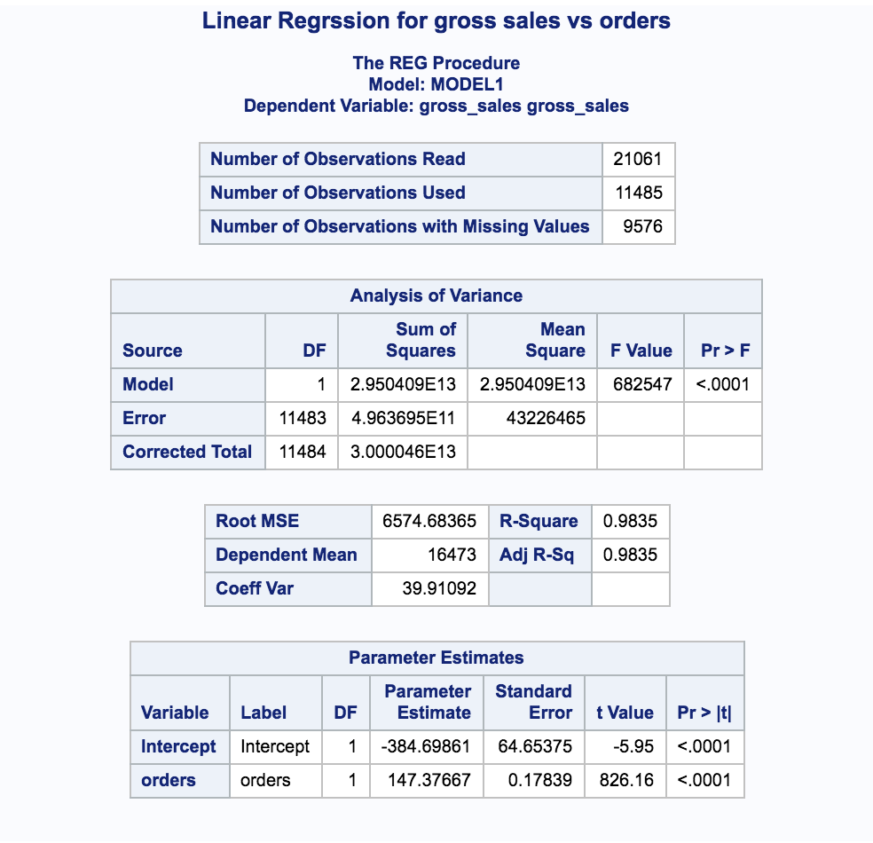
Linear Data Regression: Using PROC REG
Linear regression of gross_sales with respect to
orders
PROC REG Procedure is to fit a simple linear regression model to predict the gross_sales from orders.
Model DF is 1 because the model has one continuous predictor term, so we are estimating ß1
The corrected total DF is n-1=21060
Value of R square is 0.9835, that is 98.35% of variation of gross sales depend on the orders.

Slide 20
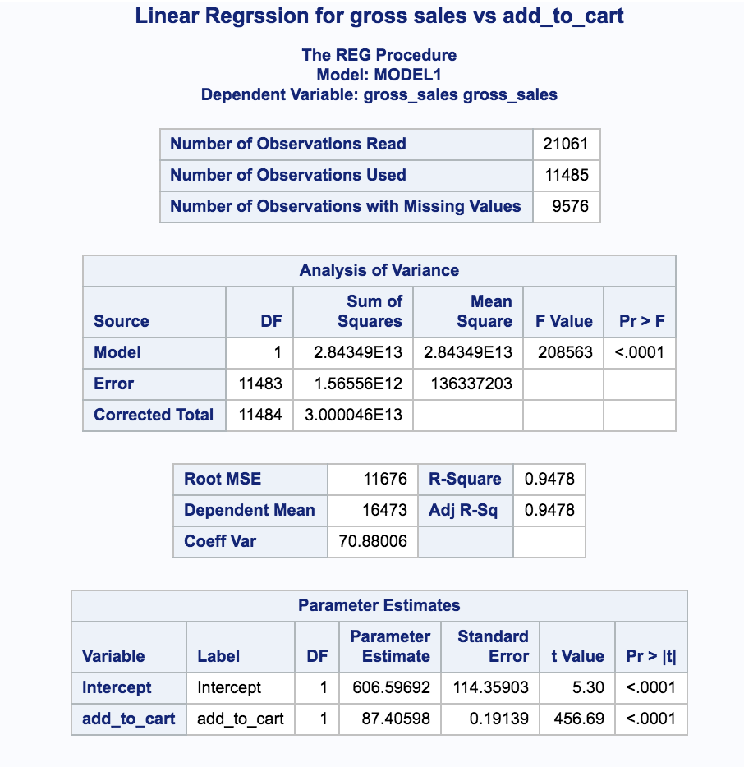
Linear Data Regression: Using PROC REG
Linear regression of gross_sales with respect to add_to_cart
The corrected total DF is n-1=21060
Value of R square is 0.9478, that is 94.78% of variation of gross sales depend on the add_to cart.

Slide 21
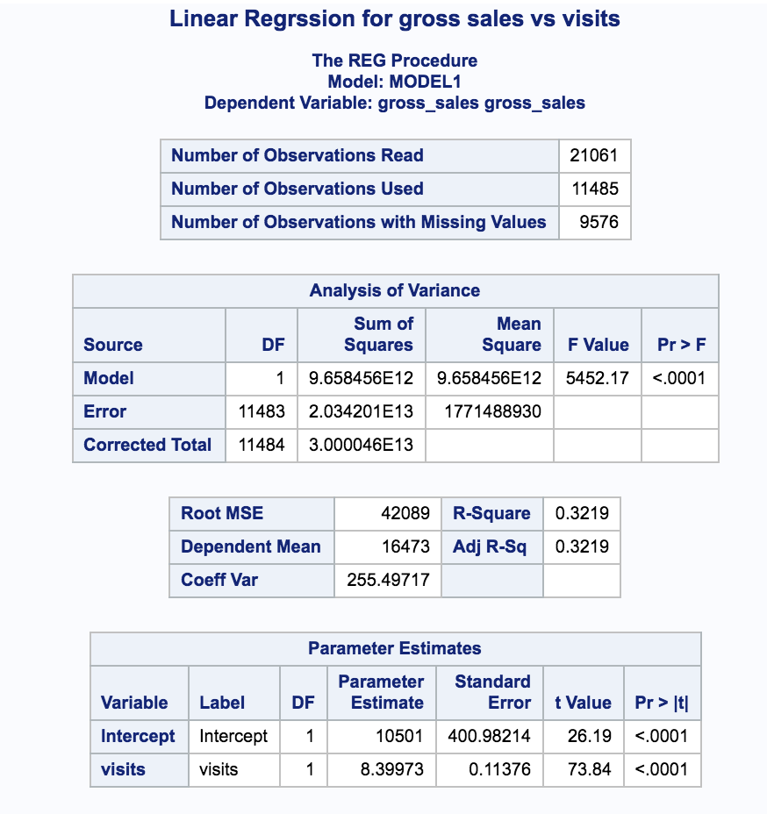
Linear Data Regression: Using PROC REG
Linear regression of gross_sales with respect to
visits
PROC REG Procedure is to fit a simple linear regression model to predict the gross_sales from visits.
Model DF is 1 because the model has one continuous predictor term, so we are estimating ß1
The corrected total DF is n-1=21060
Value of R square is 0.3219, that is 32.19% of variation of gross sales depend on the visits.

Slide 22
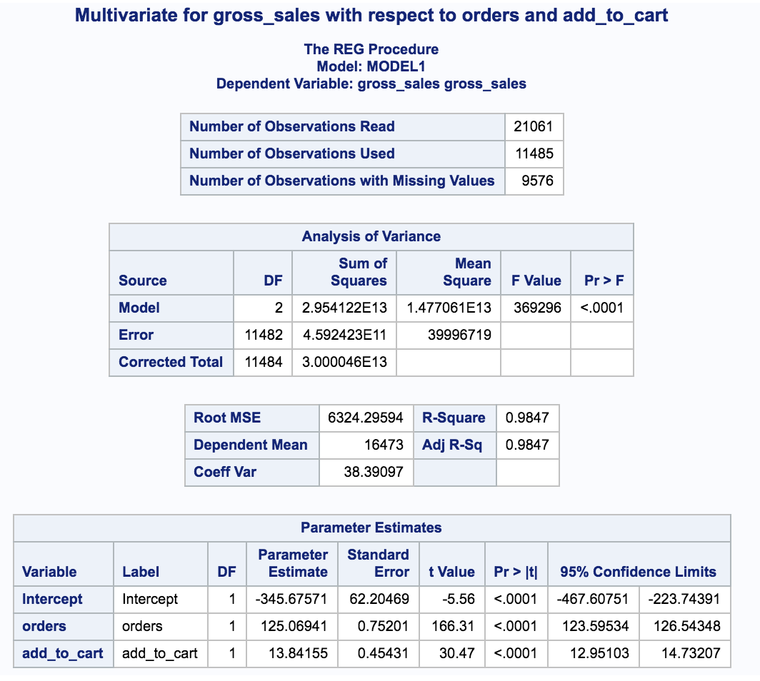
Multivariate Regression: Using PROC REG :
Gross_sales is response variable, orders and add_to_cart are predictor variables.
Adjusted R squared values is 0.9847 that means approximately 98.47% variation of gross sales is explained by the model.

Slide 23
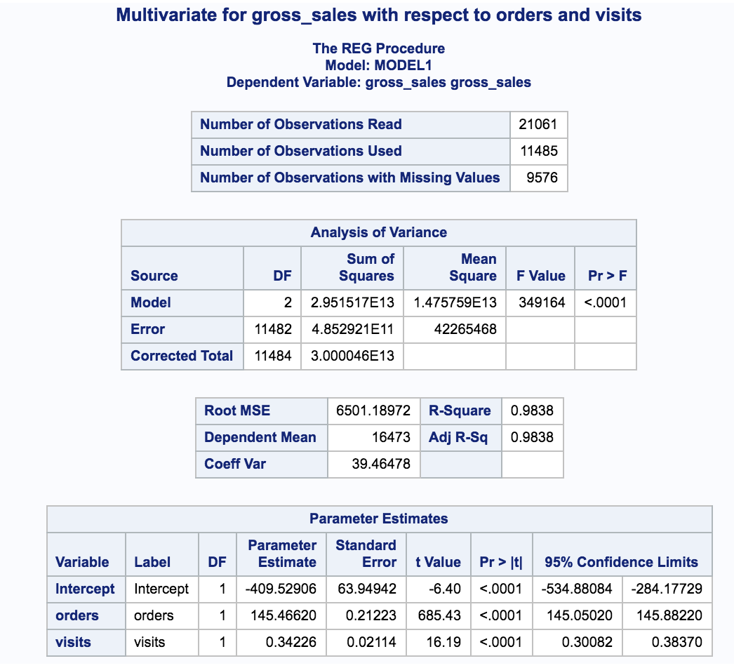
Multivariate Regression: Using PROC REG :
Gross_sales is response variable, orders and visits are predictor variables.
Adjusted R squared values is 0.9838 that means approximately 98.38% variation of gross sales is explained by the model.

Slide 24
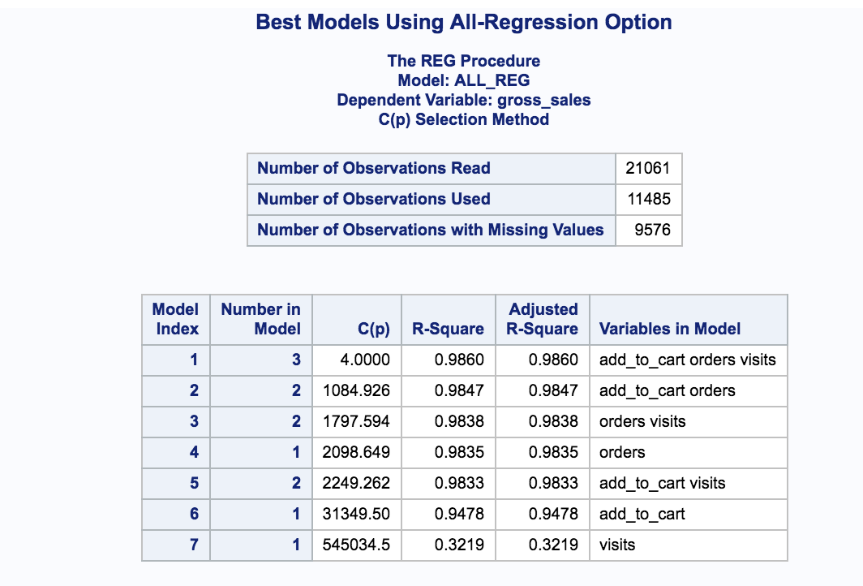
Regression Model Building: Using All-Possible Regressions Approach :
Using PROC REG to build the automatic model selection to produce all-possible regression model.

Slide 25
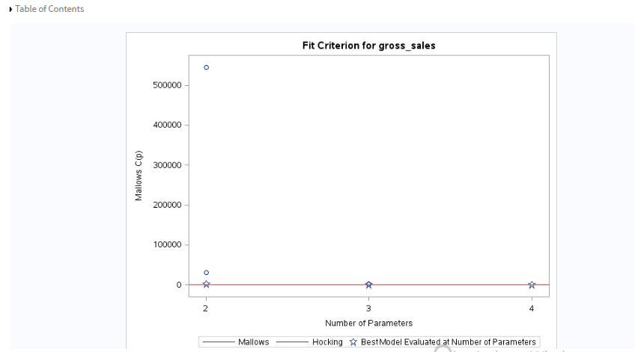
Regression Model Building: Using All-Possible Regressions Approach :
Here the gross_sales is compared with orders , add_to_cart and visits
As per the above criterion includes the predictor variables –
orders , add_to_cart and visits

Slide 26
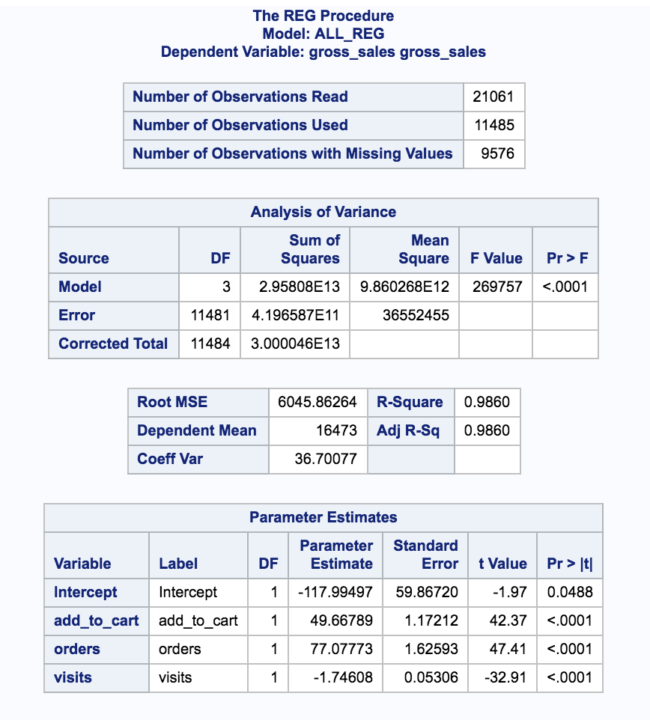
Regression Model Building: Using All-Possible Regressions Approach :
Best model selection using all possible regression approach.
Adj R sq value is 0.9860.
98.60% variance of gross sales is explained by this model.

Slide 27
Summary/Conclusions: Zappos Sales Data
Number of gross sales of an article can be increased by maximizing following predictor variables
add_to_cart
orders
visits
From the linear regression model, approximately 98.47% of the variability of gross sales is explained by the predictive variable orders.
From the multiple regression model, approximately 98.60% of the variability of gross sales is explained.
The maximum orders are placed using the Ios platform
The highest number of sales is through the Acme site for Zappos.

